Slide 1

Clean Air Forecaster
Predicting tomorrow's air quality today using NASA data
Team GOODALOCHANA: Shalvin Shabu, Ansen Vinoj, Amal Krishna M, Athira M A, Liya Roy, Prithvishankar Menon

Slide 2




Understanding the Challenge
The NASA Space Apps Challenge invited us to transform satellite data into actionable insights for cleaner skies. We examined the TEMPO mission's capabilities and identified a critical gap in public air quality awareness.
The Challenge
The Gap
The Stakes
From EarthData to Action – leveraging TEMPO mission data for healthier communities
People know today's air quality index, but remain unaware of tomorrow's potential health risks
Air pollution causes millions of premature deaths annually worldwide through NO₂, SO₂, and PM₂.₅ exposure

Slide 3
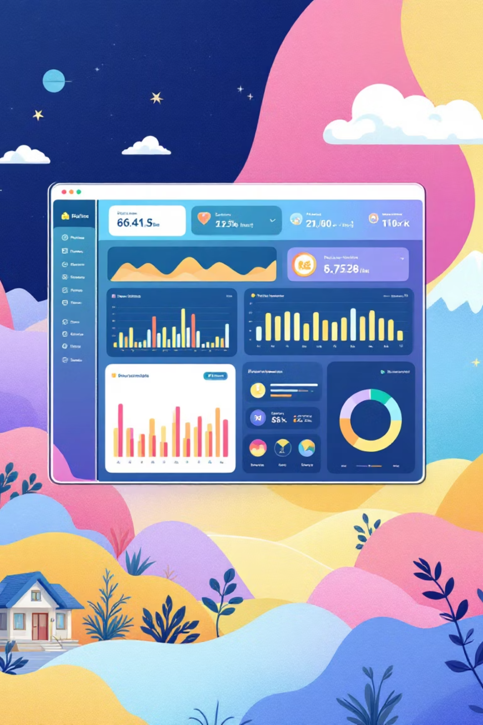
Our Solution: Clean Air Forecaster
1
Predictive Platform
Web-based application delivering 24–48 hour air quality forecasts with hourly granularity, empowering informed decision-making
2
Visual Intelligence
Interactive heatmaps reveal pollution patterns across regions, whilst location-specific forecasts provide personalised insights
3
Proactive Alerts
Intelligent notification system warns users before air quality reaches unsafe levels, protecting vulnerable populations
4
Data Fusion
Uniquely combines NASA satellite observations with artificial intelligence and meteorological data for unprecedented accuracy
Clean Air Forecaster bridges the gap between raw satellite data and actionable public health information, transforming how communities interact with air quality intelligence.

Slide 4




How It Works
Our system integrates multiple data streams through a sophisticated machine learning pipeline, transforming satellite observations into reliable forecasts.
Data Injection
NASA satellites (TROPOMI, MODIS, TEMPO) provide real-time atmospheric measurements
Weather data including temperature, wind patterns, and humidity levels
Ground sensors validate and calibrate satellite observations
Machine Learning Engine
Neural networks analyse historical patterns, learning complex relationships between atmospheric conditions and pollutant concentrations
Model continuously refines predictions based on new data, improving accuracy over time
Prediction Generation
Generates hourly AQI forecasts for 24–48 hours ahead
Creates dynamic heatmaps showing pollution movement across regions
Triggers personalised alerts when thresholds are exceeded

Slide 5








Impact & Future Vision
Who Benefits
Future Roadmap
Global Expansion
Citizens
Extend coverage beyond North America to serve communities worldwide
Families plan outdoor activities safely, protecting children and elderly members
Mobile Platform
Native iOS and Android applications with push notifications
Healthcare
Medical professionals anticipate respiratory emergency spikes
Source Tracking
Identify pollution origins: traffic congestion, industrial emissions, wildfire smoke
Policymakers
Evidence-based evaluation of environmental regulations
Schools
Informed decisions about outdoor activities and sports events
Our vision extends beyond prediction—we're building a comprehensive air quality intelligence platform that empowers communities, informs policy, and ultimately saves lives through data-driven awareness.

Slide 6

Empowering Cleaner, Safer Skies
Through the fusion of NASA satellite data, artificial intelligence, and accessible design, Clean Air Forecaster transforms atmospheric science into actionable public health protection.
Data-Driven
Leveraging NASA's TEMPO mission observations
AI-Powered
Machine learning delivers accurate forecasts
User-Focused
Intuitive design makes science accessible
Impact-Oriented
Protecting vulnerable populations proactively

Slide 7
Thank You
Team GOODALOCHANA appreciates your time and consideration
"Transforming satellite data into healthier communities—one forecast at a time"
Questions & Discussion
We welcome your questions about our methodology, prototype implementation, or future development plans. Let's discuss how Clean Air Forecaster can contribute to global air quality awareness.

